Slide 1
30-Day Diabetes Readmission
Amy Liu, Emmanuel Ekwebelem, Stephanie Low, Wenjin Kuang

Slide 2
TABLE OF CONTENTS
01.
02.
03.
04.
05.
Project Scope
Introduction
Infrastructure Project
Python Project
Visualization Project
Overview of project charter and milestones
Introduction of diabetes, dataset and project goals
Overview of infrastructure components
Overview of data cleaning and ML models
Overview of Tableau dashboard

Slide 3
01.
Project Scope

Slide 4
Project name:
Reducing 30-day Readmission Rate for diabetic patients
Project Objective:
To reduce the 30-day readmission rate for diabetic patients by analyzing a large dataset of diabetic patient records and designing a predictive model using machine learning algorithms to identify patients at high risk of readmission.
Success Criteria:
Identifies leading variables of readmission
Predictive model is accurate and reliable
Project milestones are met on time
Successful integration of predictive models into hospital’s workflow
Stakeholders are satisfied
Approach:
Python program will be used to analyze the dataset of diabetic patient records to determine the leading variables of readmission. A predictive model that identifies high risk patients will be designed and deployed. Tableau program will be used to visualize the work done in building the diabetes remission predictive model.

Slide 5
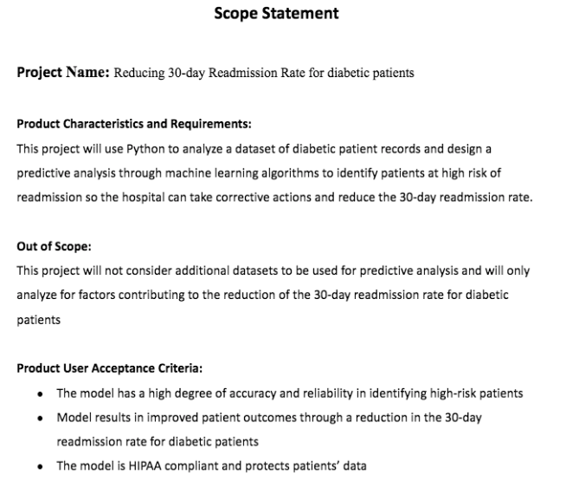
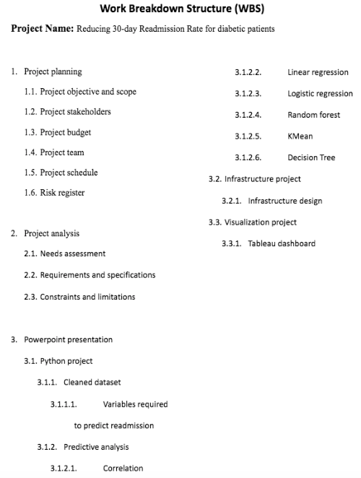

Slide 6
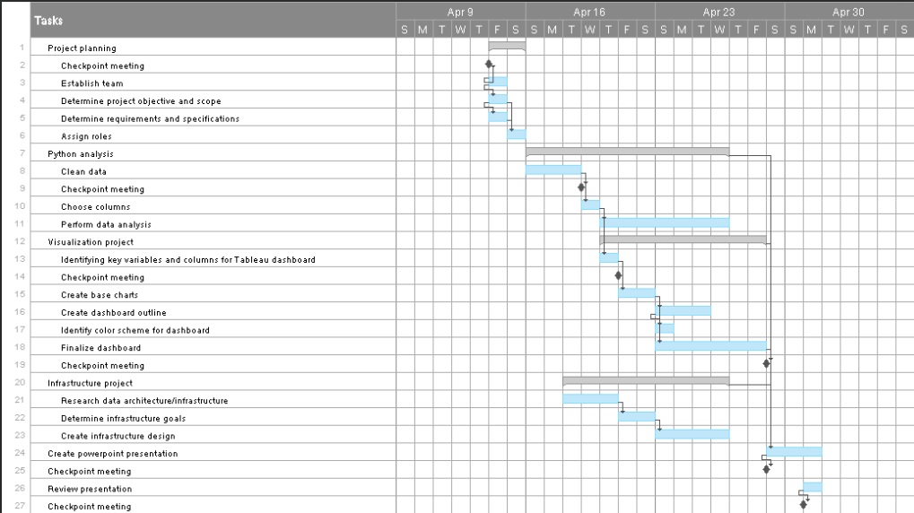
Project Schedule 4/14/2023- 5/2/2023
Key Milestones:
4/14/2023
Establishing team
4/18/2023
Data cleaning completion
4/28/2023
Finalizing dashboard
5/1/2023
Completing presentation

Slide 7
02. Background
Diabetes is a chronic medical condition characterized by high blood sugar levels due to inadequate insulin production or ineffective use of the body’s insulin. It can be caused-by or lead-to various complications affecting the heart, kidneys, eyes, and nerves. Proper management through medication, diet, exercise, and regular monitoring is essential to prevent long-term health issues.

Slide 8
Type 1
Type 2
(Hereditary) Immune system attacks the cells that produce insulin, so the body is unable to make insulin
(Lifestyle) The cells of the body do not respond to insulin produced by pancreas

Slide 9
Common Symptoms
01. - 03.
04.
Blurry Eyesight
Polydipsia
05.
Weakness & Fatigue
Polyphagia
Polyurea
06.
Unexplained Weight Loss/Gain

Slide 10
RISK FACTORS
Age
Family History
Susceptibility
Race
Comorbidities
Lifestyle
≥ 35, Children/Teens can develop Type 2 Diabetes
1 or more direct relatives have diabetes
Hx of prediabetes or gestational diabetes
African American and Asians are more susceptible
Multiple health issues increase risks
Overweight/obese, poor nutrition, inactivity and bad eating habits

Slide 11
KEY STATISTICS
37.3 Million Americans
$327 Billions/Year
22 -26% RR
28.7 million are diagnosed, 8.5 million are not
$1 out of every $4 in US health care costs is spent on caring for people with diabetes.
General Hospital Readmission Rates: 8.5-13.5%

Slide 12

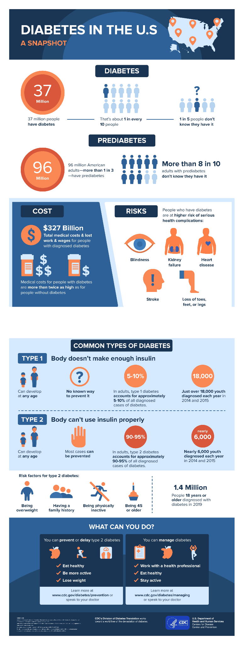
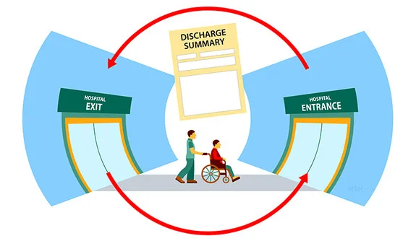
Significance

Slide 13
Diabetic Data
From : UCI ML Repository
10 Years ( 1999 - 2008) of Clinical Diabetic Data from 130 US Hospitals. To be used to construct (test, train, and deploy) a ML Model for 30-Day Diabetic Based Readmissions Prediction

Slide 14
Diabetic Data
From : UCI ML Repository
Includes patient clinical details such as :
Demographics
Diagnoses
Test Results
Medications
Hospice Information

Slide 15
Key Metrics (Demographics)
Race
Age
Gender (Sex)
Weight
Caucasian, African American, Asian, Hispanic & Other
Groups of 10 from 0 - 80 Years of Age
Male Vs. Female
Groups of 25 from 0 - 200, and ≥ 200

Slide 16
Key Metrics (Hospice)
Admission Type
Medical Specialty
Discharge Type
Diagnoses
Admission Designation i.e., Emergency, Urgent, Newborn
Specialty Designation i.e., Endocrinology, OBGyn, Pediatrics
Discharge Designation i.e., Home, Acute Care, Another Facility
Medical Diagnoses (ICD-9) i.e., [240-279] Endocrine and Immunity Disorders

Slide 17
Key Metrics (Medication)
INSULIN
METFORMIN
MAX GLU SERUM
A1CRESULT
Insulin Medication “Rate” i.e., Steady, Down, Up,
Metformin Medication “Rate” i.e., Steady, Down, Up,
Blood Sugar Level (mg/dl) i.e., Normal [ 150], Prediabetic [≥ 200], Diabetic [≥ 300]
Hemoglobin A1C Level i.e., Normal [ 150], Prediabetic [≥ 7], Diabetic [≥ 8]

Slide 18
03.
02.
Infrastructure Project
Infrastructure

Slide 19
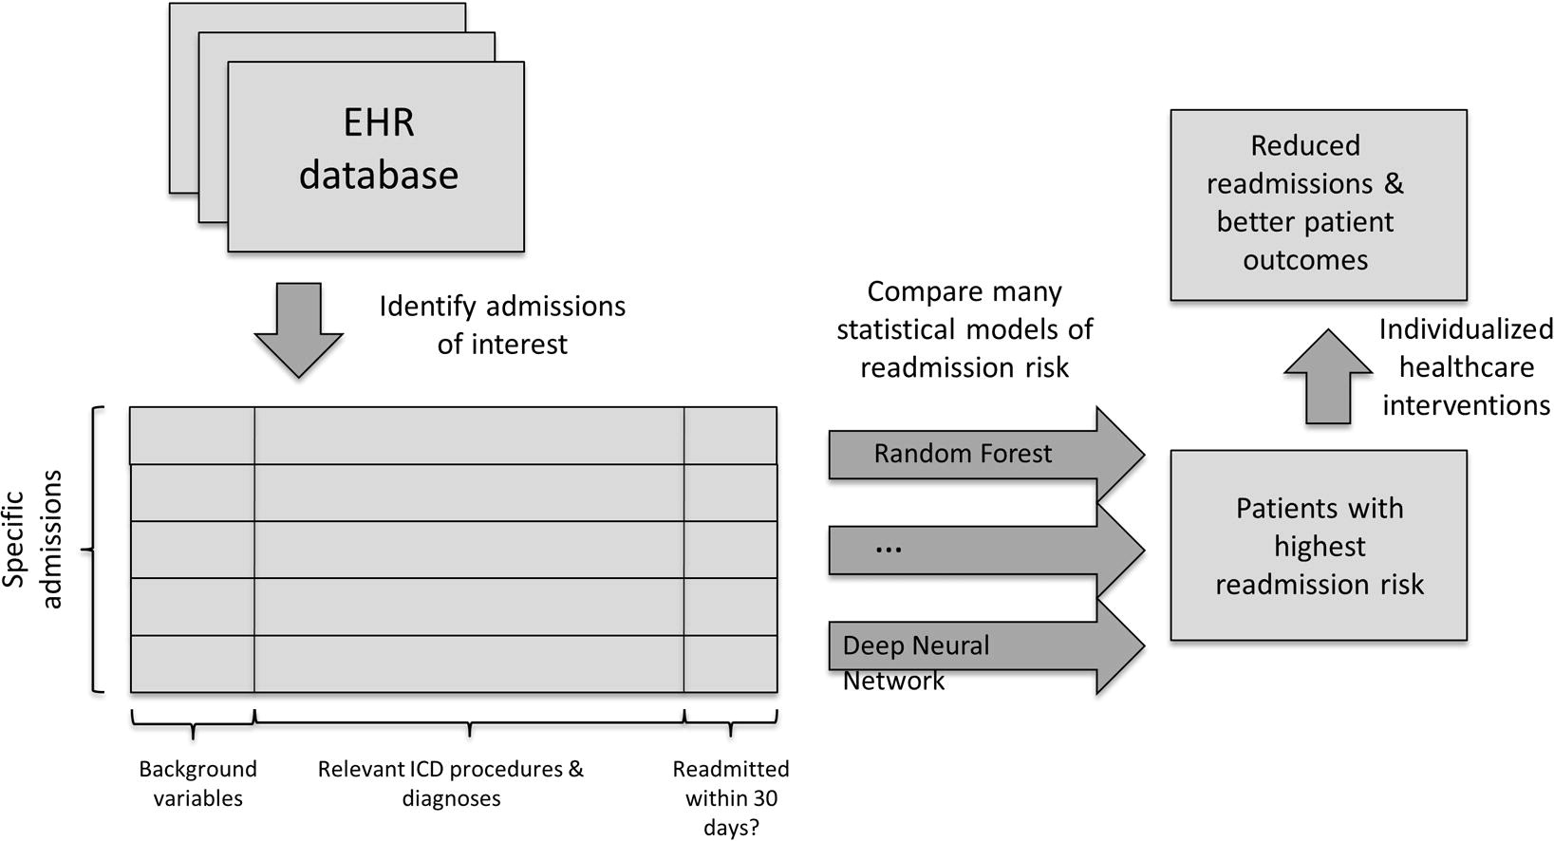
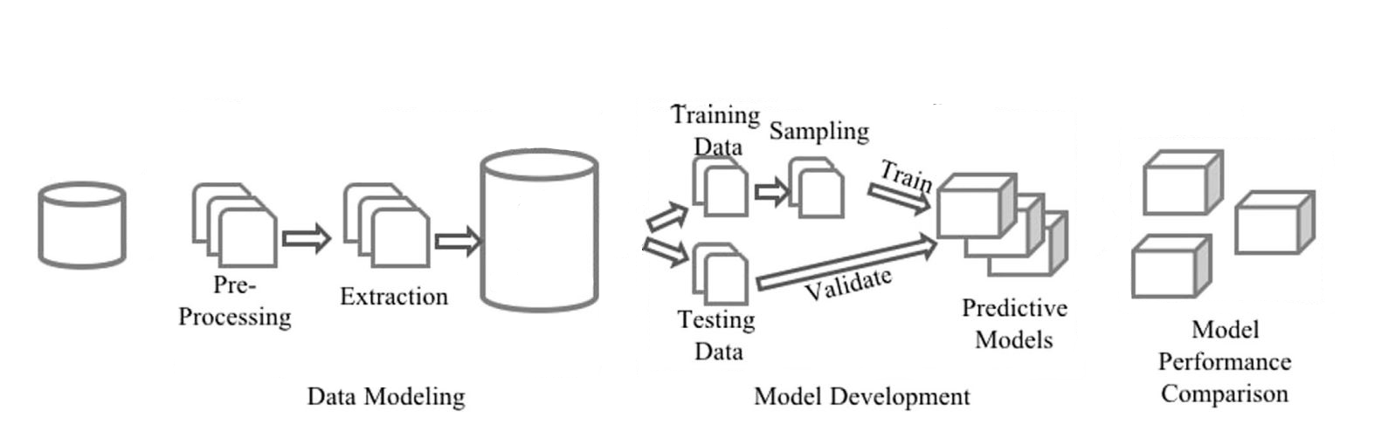

Slide 20
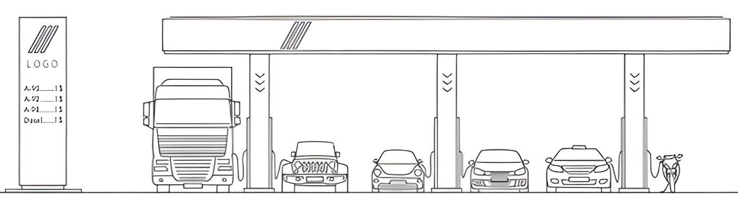

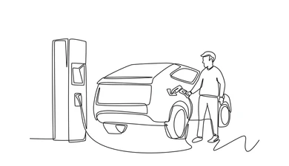

Slide 21
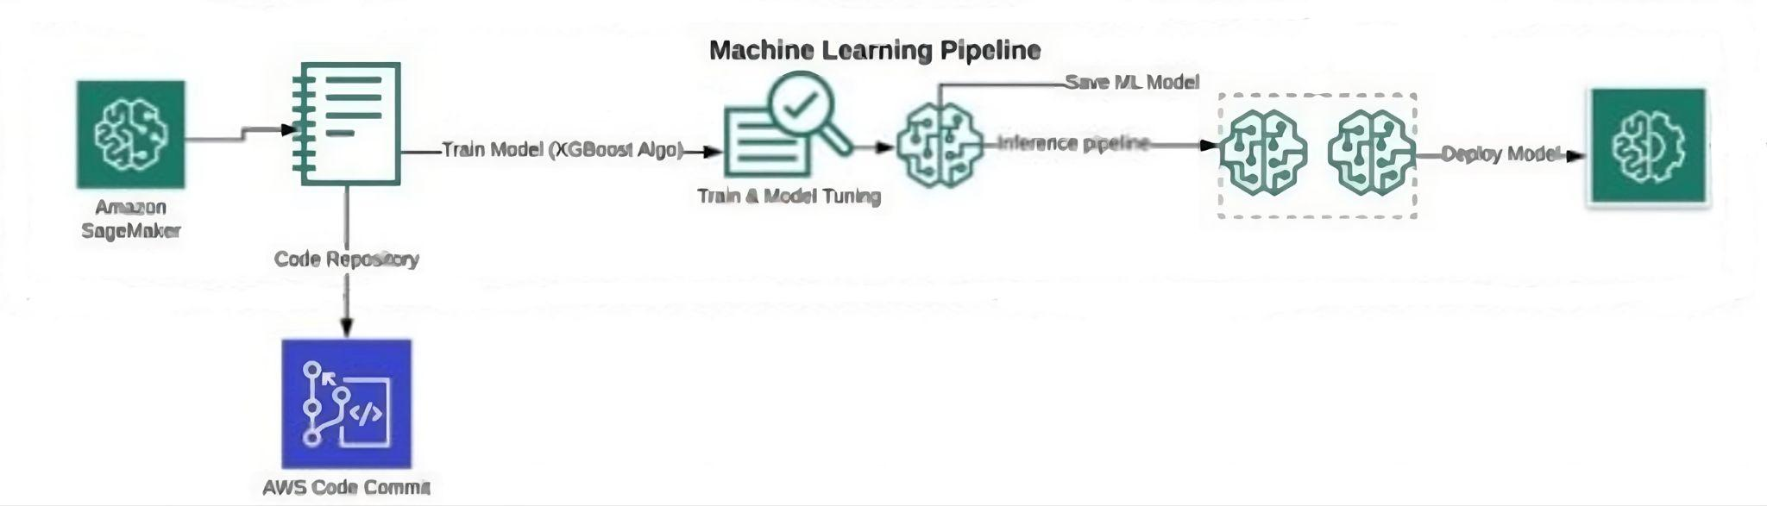
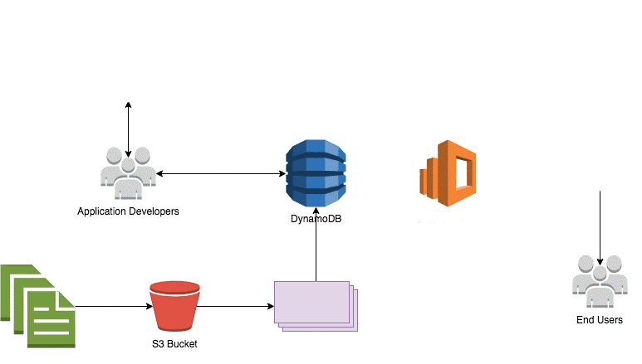



AWS Security & Monitoring Systems

Slide 22
04.
Python Project

Slide 23
Python Project Overview
Data Cleaning
Exploratory Analysis
Grouping Data, Missing Data, etc.
Review Missing Data, Categorical Data, Numerical Data
Feature Selection
ML + Hyperparameter Tuning
Feature Importance, Correlation Heat Map, Recursive Feature Elimination
Logistic Regression, Random Forest, etc.

Slide 24
Data Cleaning
Admission Source ID
Re-Admitted
Admission Type ID
'Physician Referral' 'Emergency Room' 'Clinic Referral' 'Transfer from a hospital' 'Transfer from a Skilled Nursing Facility (SNF)', 'Transfer from another health care facility' nan 'HMO Referral'
'Court/Law Enforcement' 'childbirth', 'Transfer from critical access hospital'
'Transfer from hospital inpt/same fac reslt in a sep claim', 'Transfer from Ambulatory Surgery Center'
Final Variables: ‘YES’ and ‘NO’
Final Variables: NULL 'Emergency' 'Urgent' 'Elective' 'Newborn' 'Trauma Center'

Slide 25
Data Cleaning
discharge disposition ID
Medical Specialities
nan
'home'
'acute_care'
'expired'
'left_AMA'
'hospice' 'other_healthcare_facility’
‘surgery’
‘pediatrics’
‘orthopedics’
‘ob_gyn’
‘psychiatry’
‘primary_care’
‘cardiology’
‘oncology’
‘endocrinology’
‘neurology’
‘anesthesiology’
‘radiology’

Slide 26
Data Cleaning - Diagnostic 1, 2, 3 Columns
'ENDOCRINE, NUTRITIONAL AND METABOLIC DISEASES, AND IMMUNITY DISORDERS'
'COMPLICATIONS OF PREGNANCY, CHILDBIRTH, AND THE PUERPERIUM'
'INFECTIOUS AND PARASITIC DISEASES' 'NEOPLASMS'
'DISEASES OF THE CIRCULATORY SYSTEM' 'DISEASES OF THE RESPIRATORY SYSTEM'
'INJURY AND POISONING' 'DISEASES OF THE SKIN AND SUBCUTANEOUS TISSUE'
'DISEASES OF THE MUSCULOSKELETAL SYSTEM AND CONNECTIVE TISSUE'
'DISEASES OF THE DIGESTIVE SYSTEM'
'SUPPLEMENTARY CLASSIFICATION OF FACTORS INFLUENCING HEALTH STATUS AND CONTACT WITH HEALTH SERVICES'
'SYMPTOMS, SIGNS, AND ILL-DEFINED CONDITIONS'
'DISEASES OF THE GENITOURINARY SYSTEM'
'MENTAL, BEHAVIORAL AND NEURODEVELOPMENTAL DISORDERS'
'DISEASES OF THE NERVOUS SYSTEM AND SENSE ORGANS'
'DISEASES OF THE BLOOD AND BLOOD-FORMING ORGANS' nan
'CONGENITAL ANOMALIES'
'SUPPLEMENTARYCLASSIFICATION OF EXTERNAL CAUSES OF INJURY AND POISONING'

Slide 27
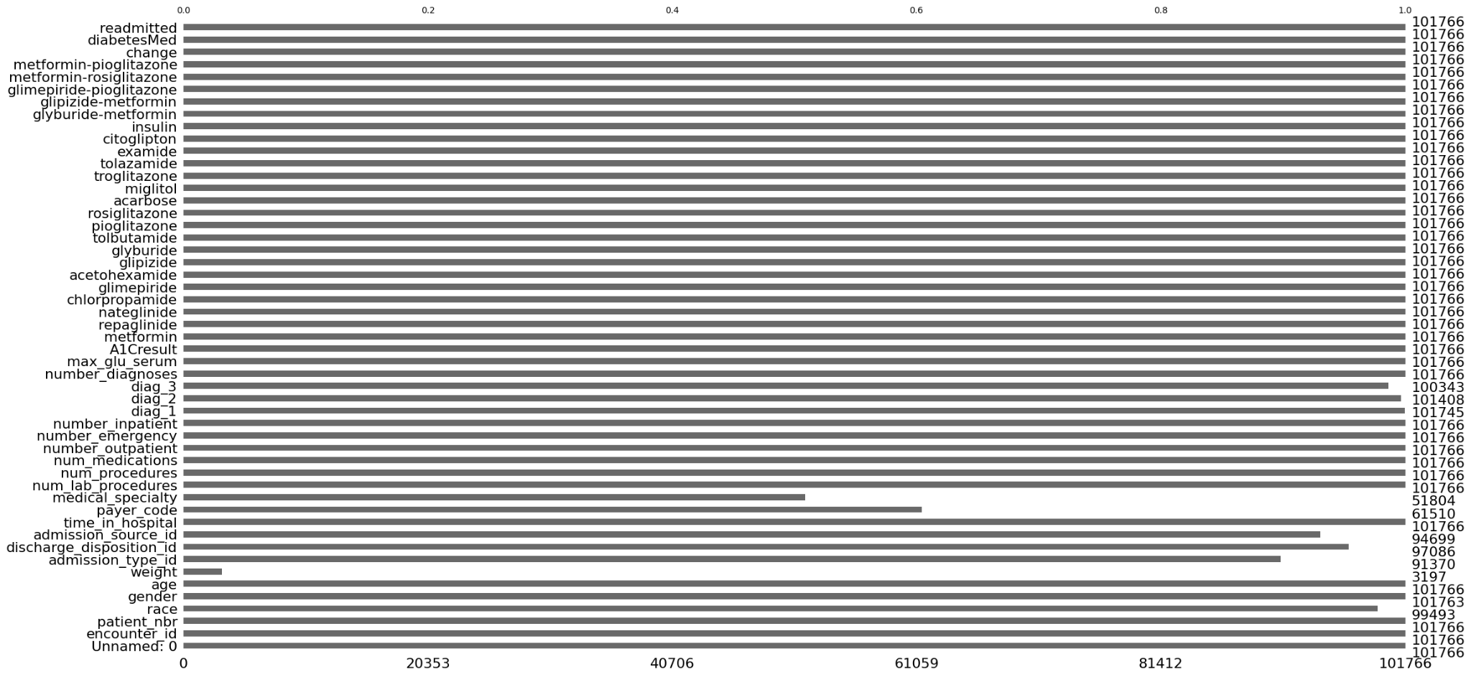
Exploratory Analysis - Missing Values
2007-2009

Slide 28
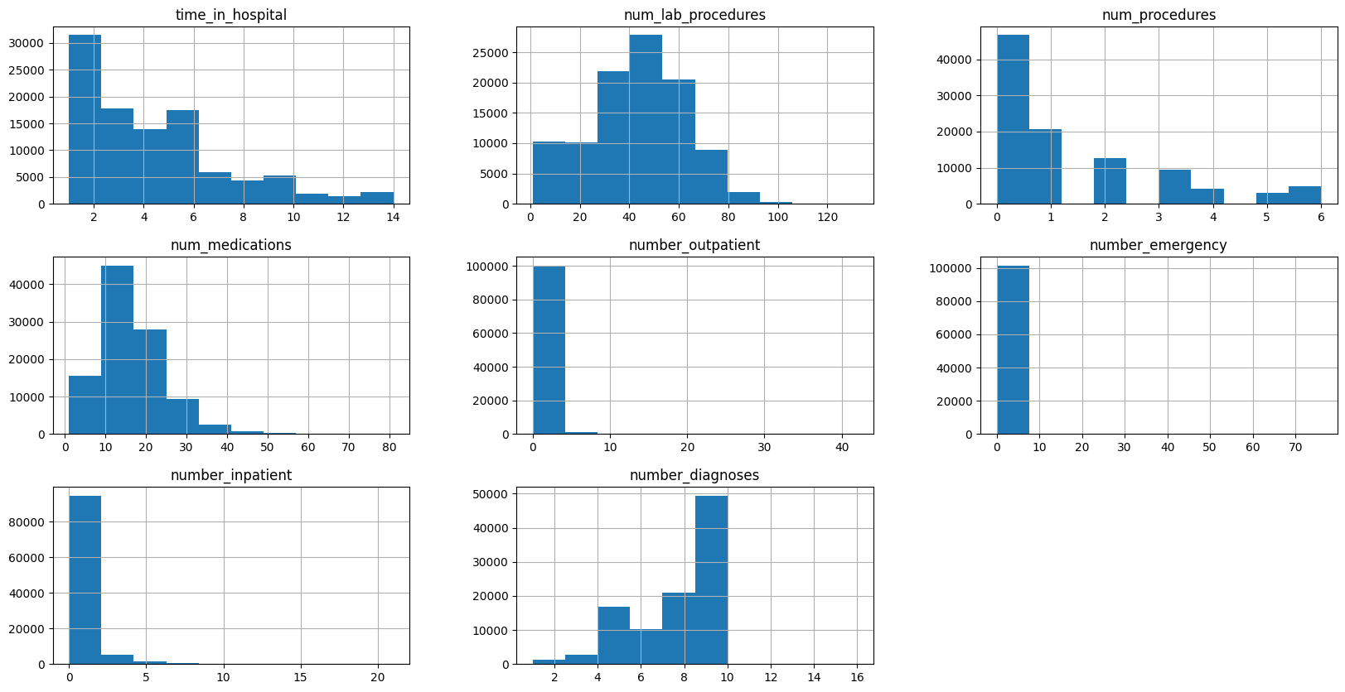
Exploratory Analysis - Numerical Features

Slide 29
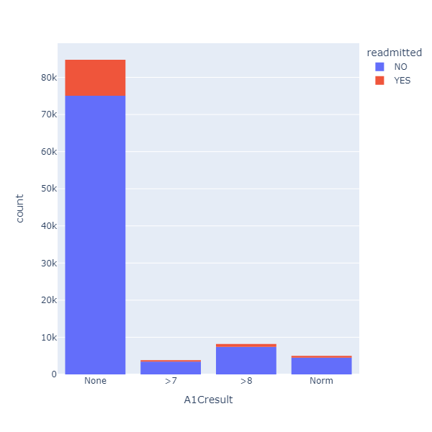
Exploratory Analysis - Bivariate Analysis
An A1C result of >7 has a probability of 10.05 % to be readmitted
An A1C result of >8 has a probability of 9.87 % to be readmitted
An A1C result of Norm has a probability of 9.66 % to be readmitted
An A1C result of None has a probability of 11.42 % to be readmitted
2007-2009

Slide 30
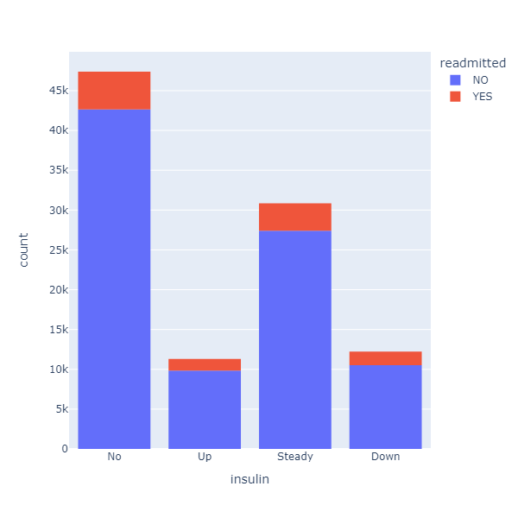
Exploratory Analysis - Bivariate Analysis cont.
An Insulin result of No has a probability of 10.04 % to be readmitted
An Insulin result of Up has a probability of 12.99 % to be readmitted
An Insulin result of Steady has a probability of 11.13 % to be readmitted
An Insulin result of Down has a probability of 13.9 % to be readmitted
2007-2009

Slide 31
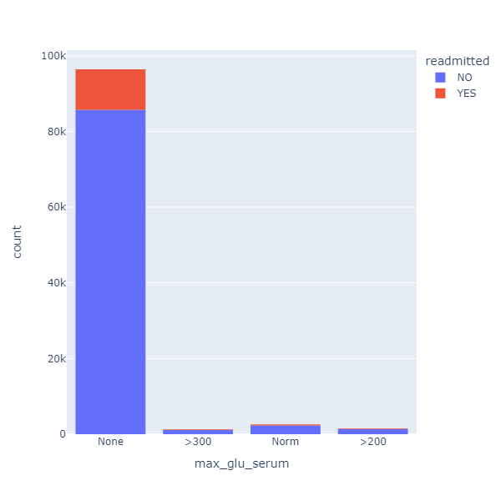
Exploratory Analysis - Bivariate Analysis cont.
A max glucose serum result of None has a probability of 11.09 % to be readmitted
A max glucose serum result of >300 has a probability of 14.32 % to be readmitted
A max glucose serum result of Norm has a probability of 11.36 % to be readmitted
A max glucose serum result of >200 has a probability of 12.46 % to be readmitted
2007-2009

Slide 32
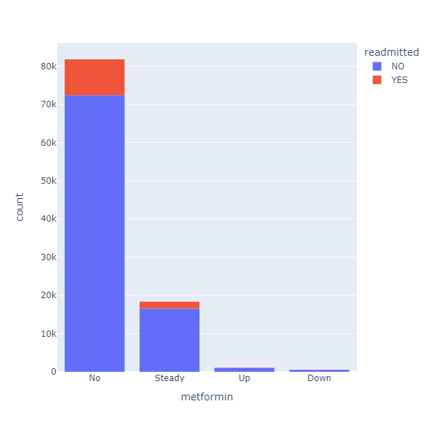
Exploratory Analysis - Bivariate Analysis cont.
A metformin result of No has a probability of 11.52 % to be readmitted
A metformin result of Steady has a probability of 9.71 % to be readmitted
A metformin result of Up has a probability of 8.25 % to be readmitted
A metformin result of Down has a probability of 12.0 % to be readmitted
2007-2009

Slide 33
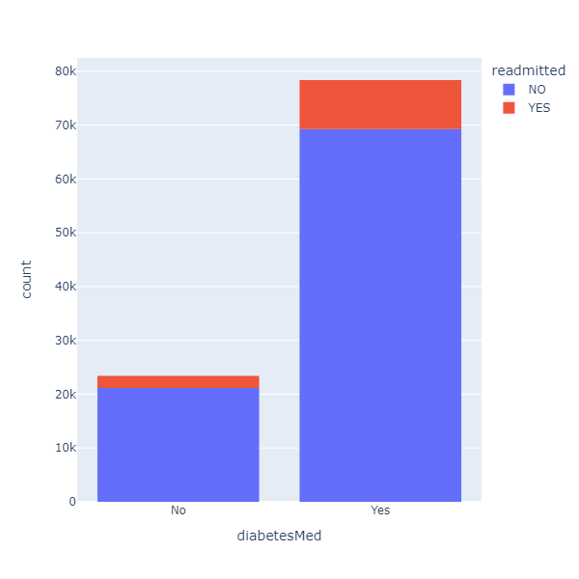
Exploratory Analysis - Bivariate Analysis cont.
A diabetesMed value of No has a probability of 9.6 % to be readmitted
A diabetesMed value of Yes has a probability of 11.63 % to be readmitted
2007-2009

Slide 34
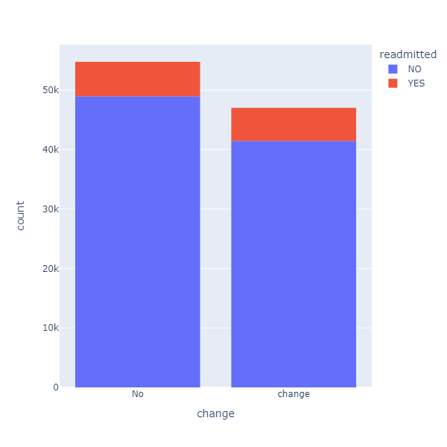
Exploratory Analysis - Bivariate Analysis cont.
A change value of No has a probability of 10.59 % to be readmitted
A change value of change (yes) has a probability of 11.82 % to be readmitted
2007-2009

Slide 35
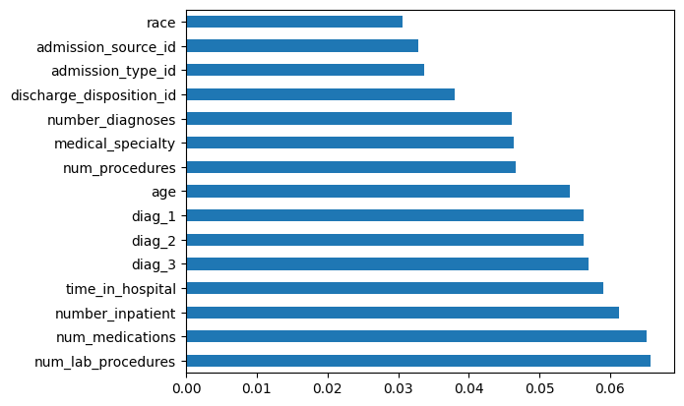
Feature Selection - Mutual Importance

Slide 36
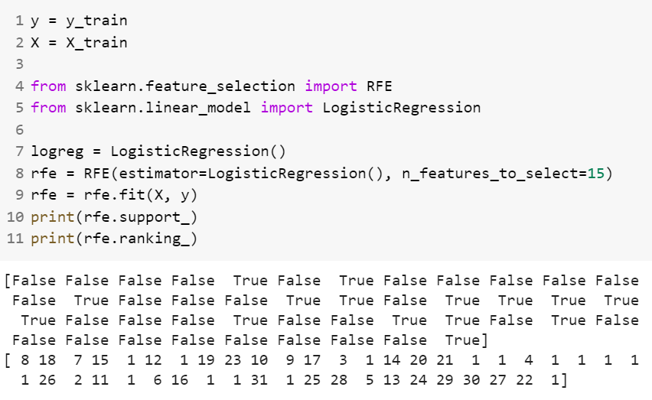
Feature Selection - Recursive Feature Elimination
Important Columns:
'diabetesMed'
'tolazamide'
'miglitol'
'acarbose'
'tolbutamide'
'glimepiride'
'chlorpropamide'
'nateglinide' 'repaglinide'
'metformin
,'max_glu_serum'
'number_diagnoses'
'number_inpatient'
'time_in_hospital'
'discharge_disposition_id'

Slide 37
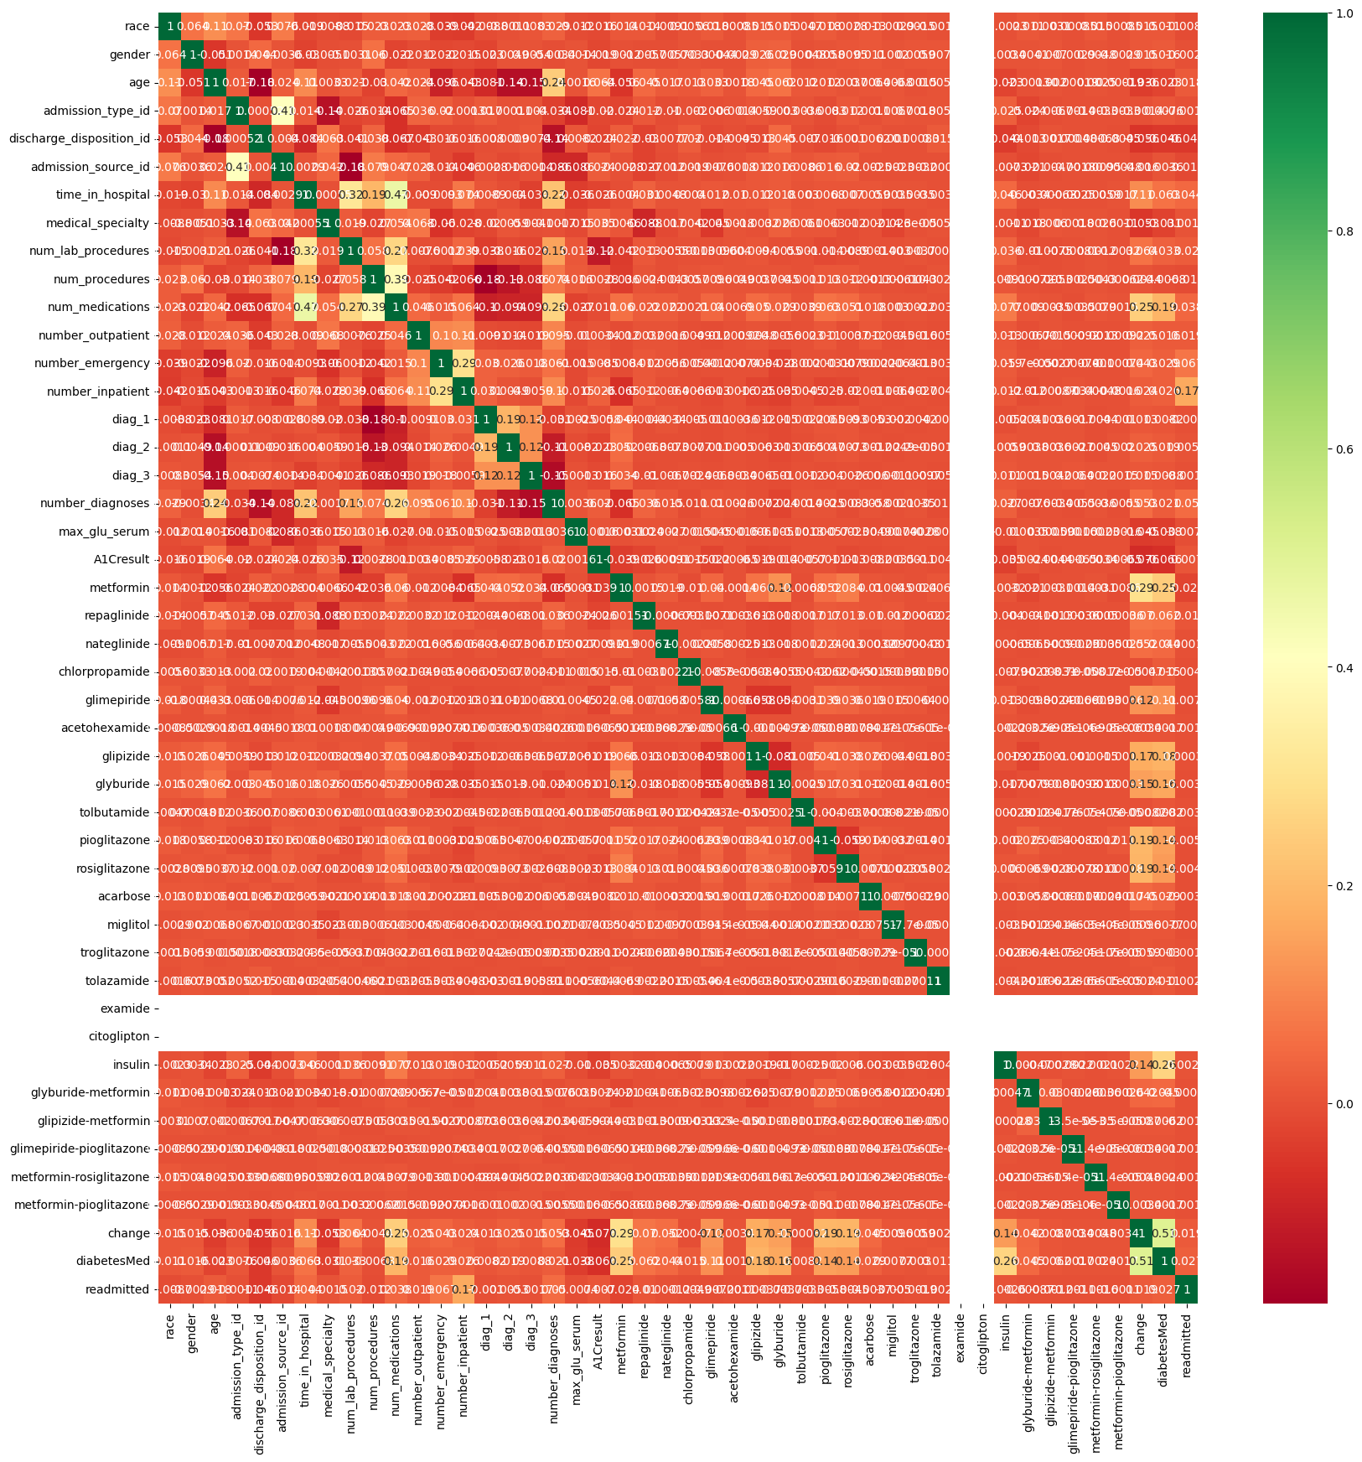
Feature Selection - Correlation Matrix
Important Columns:
'number_inpatient'
'diabetes_med'
'glimepiride'
'glipizide'
'insulin'
'change
'diabetes_med'
'glyburide’
'number_diagnoses'
'admission_type_id'
'time_in_hospital'
'admission_source_id' 'num_lab_procedures'
'num_procedures'
'num_medications'

Slide 38
Final Columns
'time_in_hospital'
'num_lab_procedures'
'num_procedures'
'num_medications'
'number_outpatient',
'number_emergency'
'number_inpatient'
'number_diagnoses'
'discharge_disposition_id'
'diabetesMed'
'max_glu_serum'
'change','metformin',
‘diag_1’,
‘diag_2’,
‘diag_3’

Slide 39
Machine Learning Results

Slide 40
Results - Without Feature Selection
 | AUC | Accuracy | Recall | Precision | Specificity | Prevalence
Logistic Regression | 0.663 | 0.646 | 0.573 | 0.172 | 0.655 | 0.111
KNN | 0.644 | 0.646 | 0.544 | 0.166 | 0.619 | 0.111
Stochastic Gradient Descent | 0.654 | 0.655 | 0.556 | 0.173 | 0.667 | 0.111
Decision Tree | 0.632 | 0.628 | 0.594 | 0.168 | 0.631 | 0.111
Random Forest | 0.669 | 0.640 | 0.618 | 0.178 | 0.643 | 0.111
Linear SVC | 0.662 | 0.879 | 0.094 | 0.340 | 0.977 | 0.111
Gradient Boosting | 0.649 | 0.609 | 0.614 | 0.164 | 0.609 | 0.111
XG Boost | 0.657 | 0.613 | 0.617 | 0.166 | 0.613 | 0.111
Cat Boost | 0.648 | 0.602 | 0.610 | 0.161 | 0.601 | 0.111

Slide 41
Results - Feature Selection
 | AUC | Accuracy | Recall | Precision | Specificity | Prevalence
Logistic Regression | 0.663 | 0.660 | 0.569 | 0.178 | 0.671 | 0.111
KNN | 0.652 | 0.658 | 0.535 | 0.170 | 0.640 | 0.111
Stochastic Gradient Descent | 0.653 | 0.661 | 0.546 | 0.174 | 0.671 | 0.111
Decision Tree | 0.633 | 0.628 | 0.584 | 0.166 | 0.613 | 0.111
Random Forest | 0.673 | 0.650 | 0.591 | 0.179 | 0.661 | 0.111
Linear SVC | 0.664 | 0.880 | 0.077 | 0.335 | 0.981 | 0.111
Gradient Boosting | 0.646 | 0.611 | 0.590 | 0.161 | 0.614 | 0.111
XG Boost | 0.650 | 0.612 | 0.612 | 0.165 | 0.612 | 0.111
Cat Boost | 0.646 | 0.605 | 0.608 | 0.161 | 0.605 | 0.111

Slide 42
Hyper-Parameter Tuning
 | AUC | RECALL | PRECISION
DECISION TREE | 0.62901127267603 | 0.6301531213191991 | 0.15853211009174312
RANDOM FOREST | 0.6773528020383 | 0.6095406360424 | 0.178171802375624
XGBOOST | 0.6402066158071 | 0.598939929328622 | 0.1611216730038023

Slide 43
BEST MODEL
0.677
Random Forest
AUC - 0.677
Recall - 0.601
Precision - 0.178

Slide 44
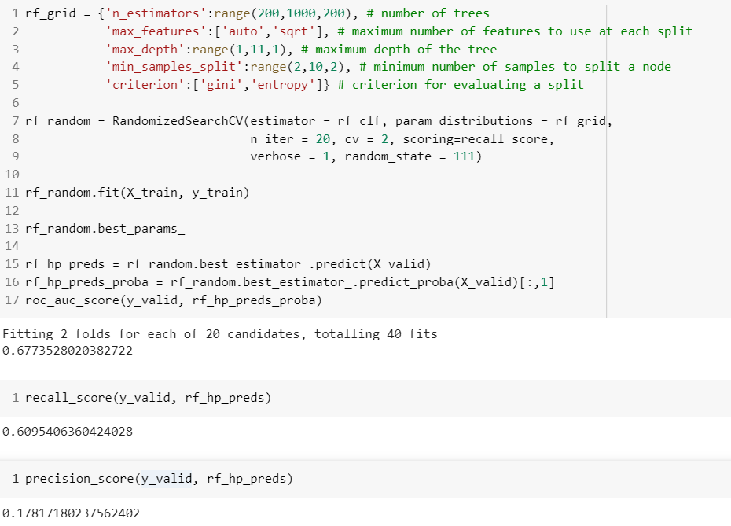

Slide 45
05.
Tableau Visualization

Slide 46
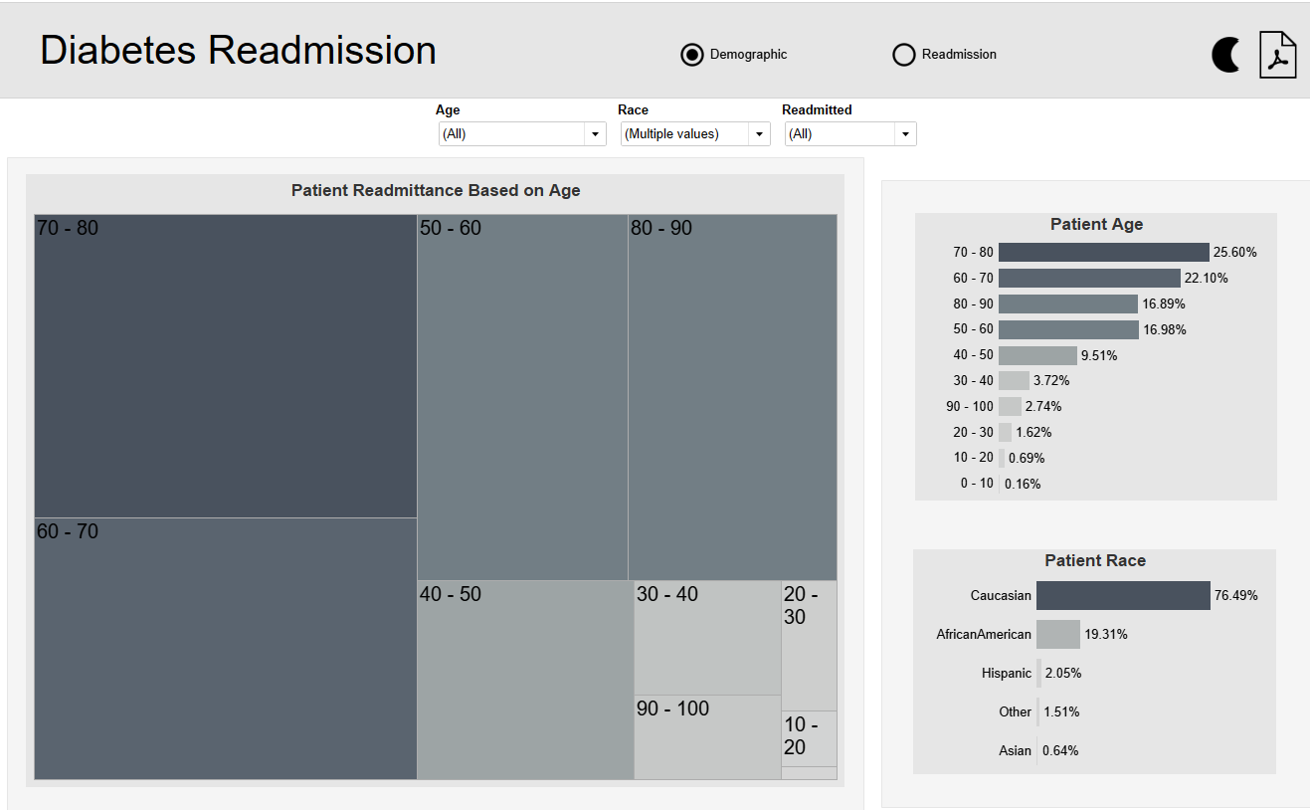
Let’s Begin the Demo

Slide 47
THANKS!
Do you have any questions?
Please keep this slide for attribution

